Slide 1
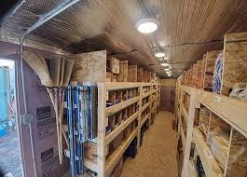
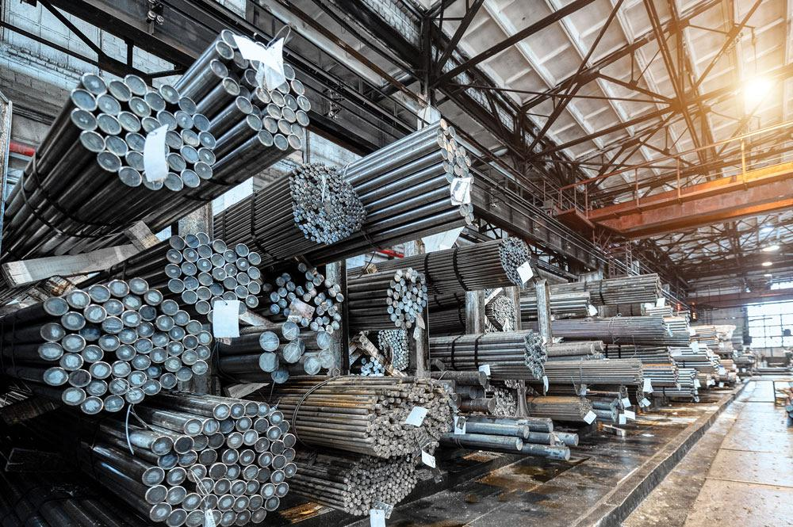
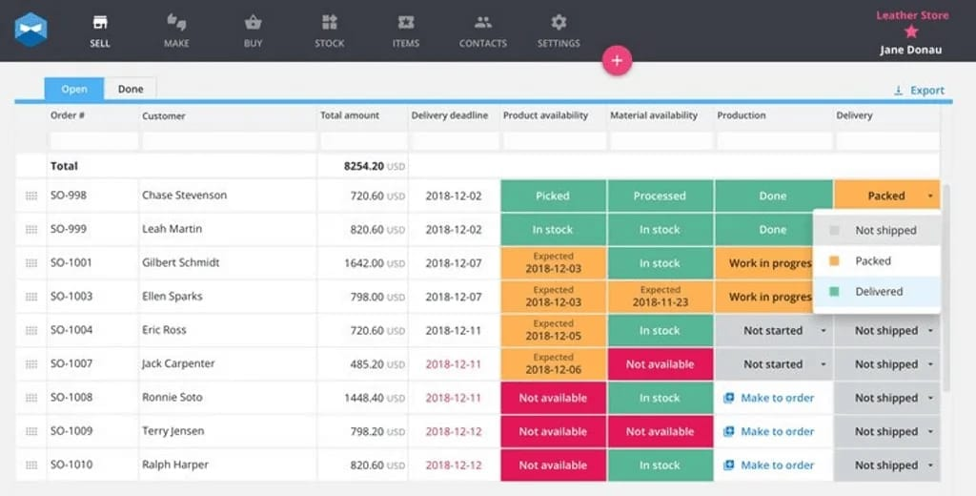
WeldWatch
By: Mason Saunders
A smart stock management system designed to prevent material shortages and real-time tracking alerts for welding operations

